Slide 1
The Role of Cryptography for Computer Security
Lecture 9

Slide 2
Contents:
1. Principles of Cryptography
2. Cryptosystems
3. Cryptographic Algorithms
4. Software for automatic encryption
5. Public Key Encryption and RSA Algorithm
6. Hash Functions
7. Digital Signatures and Certificates
8. Protocols for Secure Communications

Slide 3
1. Principles of Cryptography

Slide 4
Cryptography
Mangling information into apparent unintelligibility
Allowing a secret method of un-mangling
Mathematical techniques related to information security
About secure communication in the presence of adversaries

Slide 5
Cryptography
Cryptography deals with a set of methods which enable us to store and transmit information while safeguarding it from intruders.
Cryptography achieves this by converting data into a different form which is incomprehensible (often called ciphertext or code).
The process of converting data to ciphertext is called encryption, and the process of converting retrieving data from ciphertext is known as decryption.
Performing encryption and decryption requires secret information such as passwords (or keys).

Slide 6
Cryptanalysis
The study of methods for obtaining the meaning of encrypted information without accessing the secret information
Cryptanalysis ("the investigation of the hidden") is the art and science of breaking ciphers.
Cryptology
Cryptography + cryptanalysis

Slide 7
Steganography
Steganography ("covered writing") is the science of hiding information "in plain sight".
Unlike cryptography, the goal of steganography is to completely obscure the existence of information rather than conceal its content.

Slide 8
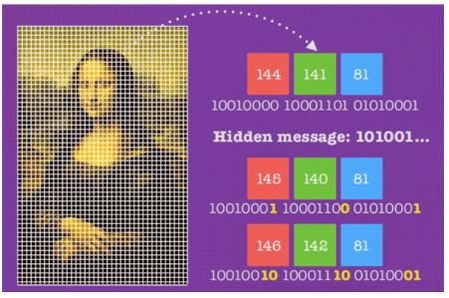
Steganography

Slide 9
Security attacks
Passive attacks
Obtain message contents
Monitoring traffic flows
Active attacks
Masquerade of one entity as some other
Replay previous messages
Modify messages in transmit
Add, delete messages
Denial of service

Slide 10
Objectives of computer security
Confidentiality (secrecy) - Only the sender and intended receiver should be able to understand the contents of the transmitted message
Authentication - Both the sender and receiver need to confirm the identity of other party involved in the communication
Data integrity - The content of their communication is not altered, either maliciously or by accident, in transmission.
Availability - Timely accessibility of data to authorized entities.

Slide 11
Objectives of computer security
Non-repudiation - An entity is prevented from denying its previous commitments or actions
Access control - An entity cannot access any entity that it is not authorized to.
Anonymity - The identity of an entity if protected from others

Slide 12
Applications of Cryptography
Government and Military
The Internet (The HyperText Transfer Protocol Secure (HTTPS))
Password Security (passwords are stored in an encrypted format)
Secure Email (Web-based email (Gmail, Yahoo, etc.) use HTTPS to encrypt email)
Business Data (it is required by law to encrypt sensitive information about customers)

Slide 13
Characters
It is general practice in cryptography to follow the standards of Rivest, Shamir and Adleman, the inventors of the RSA encryption algorithm, by using Alice and Bob as the main protagonists in any example of cryptosystem protocols.
In examples of attacks, Eve is usually cast as the attacker. That is, Alice wants to send messages privately to Bob, and Eve is trying to spy on the messages.

Slide 14
Basic principles
Confidentiality - means that cryptographic algorithms attempt to keep the contents of a message secret. If Alice is sending a message to Bob, it should be impossible or computationally infeasible for Eve to learn the contents of an encrypted message without knowledge of the secret key.
Integrity - means that a cryptographic algorithm verifies that a message was not modified in transit. For example, assume that Alice encrypts a message to Bob by encoding each letter as its position in the alphabet (A=1, B=2, etc.). If Eve can intercept the message, she can modify the message without Bob knowing.

Slide 15
Basic principles
Authentication - ensures that the message was originated from the originator claimed in the message. Suppose, Alice sends a message to Bob and now Bob wants proof that the message has been indeed sent by Alice. This can be made possible if Alice performs some action on message that Bob knows only Alice can do.
Non-repudiation - means that someone cannot deny that they sent a message. For example, Alice could go to Bob's car lot and pick a car. She could then send Bob an encrypted message saying that she wants the car and providing payment. Later, if Alice went to court claiming that she never wanted that car and that Bob faked the message from her, Bob couldn't prove to the judge that Alice sent the message.

Slide 16
Design Principle for Cryptography: Kerckhoff's Principle
Auguste Kerckhoffs’ principle recommends that encryption algorithms should be public while the keys should be a secret.
Cryptographic system should be designed to be secure, even if all its details, except for the key, are publicly known
The system should be indecipherable in practice, if not theoretically
The system’s design should not require secrecy and its compromise should not be a hassle for a correspondent

Slide 17
Design Principle for Cryptography: Kerckhoff's Principle
The encryption key should be memorized and recalled without notes and should be convenient to modify
The system should have the ability to transmit the cryptograms by telegraph
The documents or equipment for the system should be easy to port and allow for one-person use
The system should be easy, neither carrying a long list of rules nor requiring mental strain for implementation

Slide 18
2. Cryptosystems
A cryptosystem is a pair of algorithms: one for the encryption of data and another for decryption.
Encryption: The process of converting data into its cryptic form that prevents unauthorized access, i.e. converting plaintext to ciphertext. This process requires encryption keys which provide information regarding the specific implementation of a given encryption algorithm.
Decryption: The process of converting encrypted data back into its original form for use, i.e. converting ciphertext back to plaintext. Decryption requires a decryption key which provides the specific information required to ‘undo’ the encryption.

Slide 19
Definitions
Plaintext: The original message in its original legible form.
Ciphertext: Encrypted text that will appear to be a random string.
Cipher: A system of encryption that maps each character to a substitute.
Code: A system of encryption that maps each word or feature to a substitute.
Shift Cipher: A cipher that replaces each character with another chosen by moving forwards through the alphabet by some fixed shift factor.

Slide 20
Definitions
Symmetric Key Cryptosystems: Cryptosystems that use the same key for encryption as well as decryption. This key is assumed to be a shared secret between the two parties exchanging messages.
Asymmetric or Public Key Cryptosystems: Cryptosystems that use public-private key pairs. This enables anyone to encrypt messages for sending to the publisher of the keys (using the public key) but only the holder of the private key will be able to decrypt the messages.
Digital Signatures: A digital code (generated and authenticated by public key encryption) which is attached to an electronically transmitted document to verify its contents and the sender’s identity.

Slide 21
Number theory terms
Modulo: The remainder operator (e.g. 17 modulo 5 is 2, i.e. 17 when divided by 5 leaves a remainder of 2). This is often shortened to mod, we write 17 ≡ 2 (mod 5), read as "17 is congruent to 2, modulo 5".
Coprime: In number theory two values are said to be coprime or relatively prime if they do not share any common prime factors. That’s to say that their greatest common divisor (GCD) or highest common factor is 1.

Slide 22
Symmetric vs Asymmetric Cryptosystems
A cryptosystem consists of an encryption algorithm, a decryption algorithm and some secure private key at a minimum.
The key may consist of multiple parts and under certain circumstances parts of this key may be made public.

Slide 23
Symmetric Cryptosystem
Symmetric cryptosystems use the same key for encryption and decryption.
Symmetric cryptosystems are used following secure key exchanges in bilateral communications

Slide 24
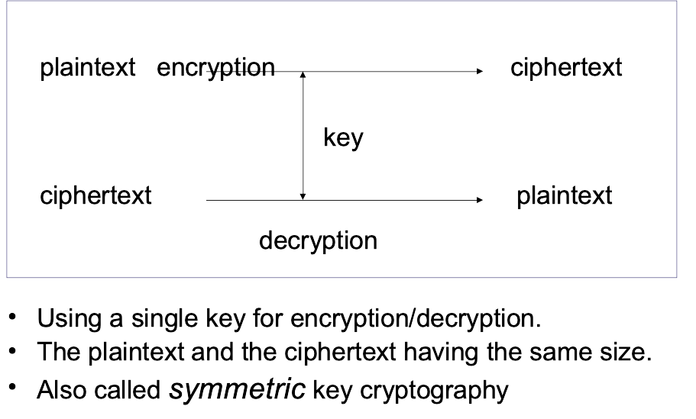
Symmetric Cryptosystem

Slide 25
Security uses
Transmitting over an insecure channel
The transmitted message is encrypted by the sender and can be decrypted by the receiver, with the same key
Prevent attackers from eavesdropping
Secure storage on insecure media
Data is encrypted before being stored somewhere
Only the entities knowing the key can decrypt it

Slide 26
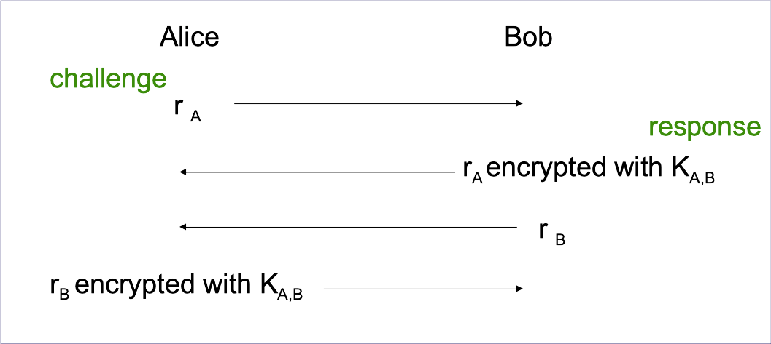
Security uses: Strong authentication - proving knowledge of a secret without revealing it.

Slide 27
Security uses: Integrity Check
Noncryptographic checksum
Using a well-known algorithm to map a message (of arbitrary length) to a fixed-length checksum
Protecting against accidental corruption of a message
Cryptographic checksum
A well-know algorithm
Given a key and a message
The algorithm produces a fixed-length message authentication code (MAC) that is sent with the message

Slide 28
Asymmetric Cryptosystem or Public-Key Cryptosystem
These are cryptosystems where the encryption key differs from the decryption key.
This means that the encryption key can be made public so that anyone may encrypt messages and send them to the holder of the decryption key for them and only them to decipher.
Examples of asymmetric cryptosystems include the RSA and ElGamal cryptosystems.

Slide 29
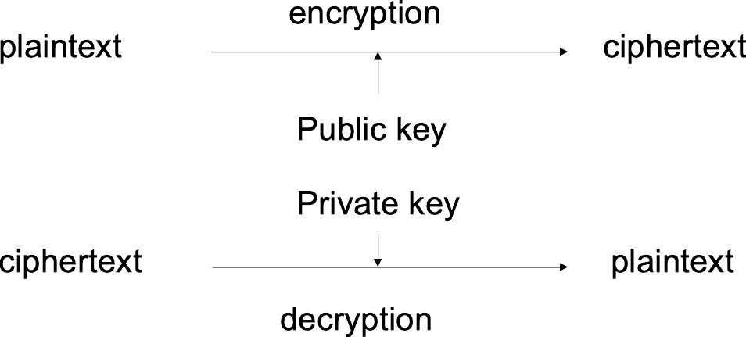
Asymmetric Cryptosystem or Public-Key Cryptosystem
Each individual has two keys
a private key (d): need not be reveal to anyone
a public key (e): preferably known to anyone

Slide 30
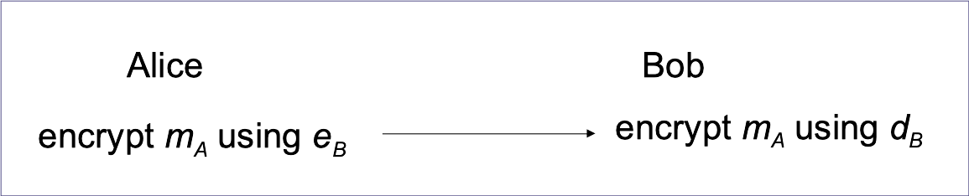
Security uses:
Transmitting over an insecure channel
Secure storage on insecure media
Data is encrypted with the public key of the source, before being stored somewhere
Nobody else can decrypt it (not knowing the private key of the data source)

Slide 31
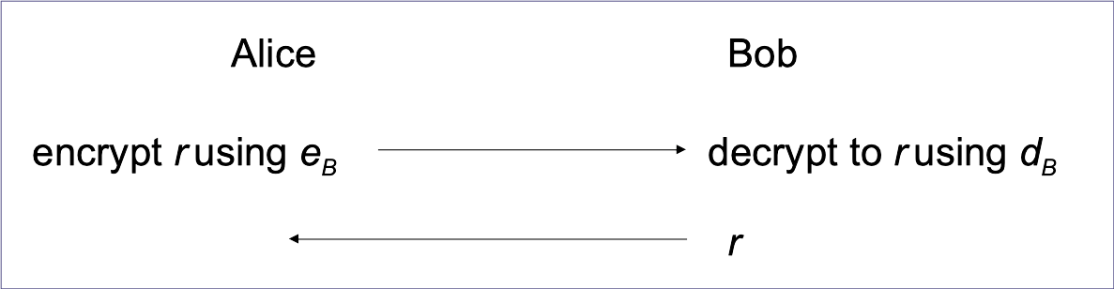
Security uses: Authentication

Slide 32
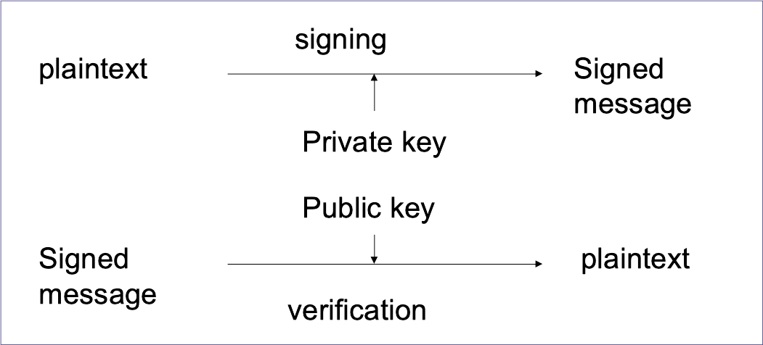
Security uses:
Digital Signatures
Proving that a message is generated by a particular individual
Non-repudiation: the signing individual can not be denied, because only him/her knows the private key.

Slide 33
3. Cryptographic Algorithms
Shift Ciphers – two parties determine a number between 1-25, and shift the letters that number of spaces in the alphabet. The shift number serves as the key.
Substitution Ciphers – These ciphers replace plaintext with cipher text using an algorithm that is a fixed system. The key is the document that shows the fixed system, which can be used to reverse engineer the encryption.

Slide 34
Substitution ciphers
Ceasar's method - replace every letter in the alphabet with the letter 3 away
A - > D
B - > E
C - > F
. . .
X - > A
Y - > B
Z - > C

Slide 35
Substitution ciphers: Caesar Cipher
Each letter is translated a fixed number of positions in the alphabet
Ci = E(pi ) = pi + 3
A B C D E F G H I J K L M N O P Q R S T U V W X Y Z
D E F G H I J K L M N O P Q R S T U V W X Y Z A B C
Substitute the letters in the second row for the letters in the top row to encrypt a message
Encrypt(COMPUTER) gives FRPSXWHU
Substitute the letters in the first row for the letters in the second row to decrypt a message
Decrypt(Encrypt(COMPUTER)) = Decrypt(FRPSXWHU) = COMPUTER

Slide 36
Substitution ciphers
Use a key to scramble the letters
A B C D E F G H I J K L M N O …
c i p h e r s a b d f g j k l …
Rearrange using a fixed distance between letters (e.g. every 3rd)
A B C D E F G H I J K L M N O …
a d g j m p s v y b e h k n r …

Slide 37
Cryptoanalysis of Substitution Ciphers
Brute force would require trying checking 26! permutations which at one permutation per microsecond would take over a thousand years
Look for short words, words with repeated patterns, common first and last letters
Look at frequency distributions
Could reduce time to hours

Slide 38
Cryptographic Algorithms
Transposition Ciphers – This algorithm uses a set of rules, which serve as the key, to change the order of the text into a different permutations that can then be encrypted. Common examples are Rail Fence and Route ciphers.
Polyalphabetic Ciphers – These are a type of substitution cipher that use multiple alphabets to further complicate unauthorized decryption of the ciphertext.
Nomenclator ciphers – A type of substitution cipher that replaces common plaintext words with symbols to try and throw off a specific form of cryptanalysis.

Slide 39
Transposition Ciphers
Columnar Transposition rearranging plaintext message into columns and then reading it row by row
“YES COMPUTER SECURITY IS FUN” would be written
Y M R R S
E P S I F
S U E T U
C T C Y N
O E U I X
is encrypted as “ymrrs epsif suetu ctcyn oeuix” where the X is just filler.
Transposition algorithms require a constant amount of time per character and are O(n) algorithms, but space required to store results and delay in waiting for all characters to be read are dependent on the size of the plaintext

Slide 40
Cryptoanalysis of Transposition Algorithms
Compute letter frequencies of ciphertext; if appear with normal frequency, then assume a transposition algorithm was used
By shifting text, look for common digrams (e.g EN)and trigrams (e.g. ENT)

Slide 41
Most common algorithms today are:
Asymmetric Encryption – This is the Public Key example we just gave. One key encrypts, the other key decrypts. The encryption only goes one way. This is the concept that forms the foundation for PKI (public key infrastructure), which is the trust model that undergirds SSL/TLS.
Symmetric Encryption – This is closer to a form of private key encryption. Each party has its own key that can both encrypt and decrypt. As we discussed in the example above, after the asymmetric encryption that occurs in the SSL handshake, the browser and server communicate using the symmetric session key that is passed along.

Slide 42
Modern Encryption Algorithms

Slide 43
AES – AES stands for Advanced Encryption Standard
Designed in response to a call by NIST in 1998, and officially adopted in 2001
Block length is 128 bits, and keys can be 128, 192, or 256 bits.
Essentially, proceeds in 4 rounds (which are repeated):
Substitute bytes
Permute
Mix columns
Add round key

Slide 44
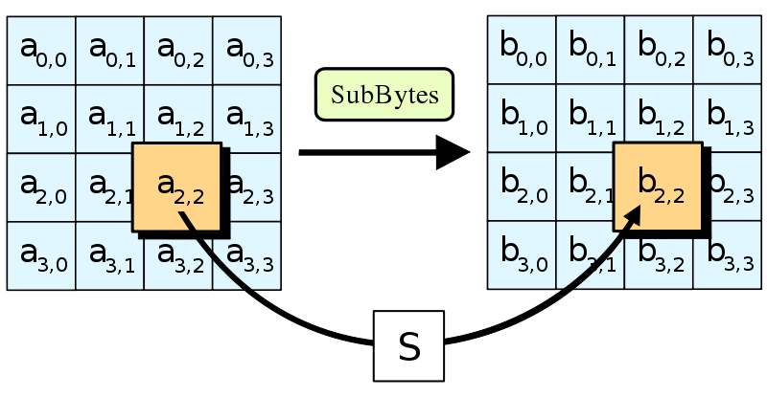
Stage 1: substitute bytes
AES computes a matrix which maps every 8-bit value to a different 8-bit value
Computed using properties of finite fields (go take some math classes to learn more about this)

Slide 45
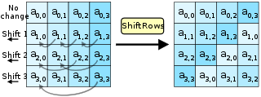
Stage 2: permute
AES then shifts each row, where each row is shifted a different amount

Slide 46
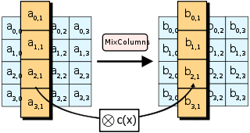
Stage 3: Mix columns
Here, the 4 bytes in each column are combined using a linear transformation
Essentially, the output of any byte depends on all the input bytes, so this “mixes” them together

Slide 47
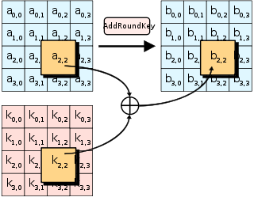
Stage 4: Add round key
Use XOR (Exclusive Or) to combine the key with the message
XOR operates on binary data. It returns true if both of its inputs are opposites (one false and one true), otherwise, it returns false.

Slide 48
Modern Encryption Algorithms
RSA – RSA stands for Rivest-Shamir-Adlemen, after its creators, it is a public key encryption algorithm (asymmetric) that has been around since 1978 and is still widely used today. It uses the factorization of prime numbers to encipher plaintext.
ECC – ECC stands for Elliptic Curve Cryptography, which relies on the algebraic structure of elliptical curves over finite fields. Although ECC has been around since 1985, it’s only been in use since about 2004. ECC has distinct advantages over RSA and is likely going to play a more prominent role in the future of SSL/TLS.
PGP – PGP stands for Pretty Good Privacy, it was created in 1991 by Phil Zimmerman. It’s really more of a collection of algorithms than a single one, all for hashing, data compression and both public and private key cryptography. Each step uses a different algorithm. PGP has been criticized for poor usability, a lack of ubiquity and for the length of its keys.

Slide 49
4. Software for automatic encryption
BitLocker
FileVault 2
Linux Unified Key Setup (LUKS)
VeraCrypt
CipherShed
DiskCryptor
Encrypto
AESCrypt
nCrypted Cloud
Virtual Private Network (VPN)
HTTPS
OpenPGP
WhatsApp
Telegram
Duplicati
OpenSSL
USB Flash Security

Slide 50
5. Public Key Encryption and RSA Algorithm
The RSA algorithm allows communication between two people without the requirement that the two people establish a shared secret key.
Diffie-Hellman Key Exchange is used to establishing a shared secret key so that symmetric key algorithms we discussed in the previous section can be used thereafter.
Digital Signature Algorithm is used for, well, digital signatures.
The RSA Cryptosystem is a method of encryption wherein the security of any encrypted message stems from the difficulty in factoring large numbers into their primes.

Slide 51
Public-Key Cryptography
This public-private split maintains secrecy and security whilst enabling anyone to send a message to the publisher of the public key.
In particular, anyone can encrypt using a public key but private keys are necessary for decryption and forming public keys.
Public-key cryptography also has applications in authentication since the public key is derived from one’s private key and hence methods can be designed to prove that you must be the owner of that key.

Slide 52
Public-Key Cryptography
Finding Prime Factors
The security of any encryption comes from the notion of one-way functions or operations that are easy to do yet near impossible to undo without information on how the initial calculation was made. This means that encryption is efficient and attacks will be unsuccessful.
The security of RSA encryption comes from the “factoring problem” – it is almost impossible (with current technology) to factor a large number into its prime factors. However, it is simple to calculate the product of a set of prime numbers.

Slide 53
Asymmetric Encryption
Choose two large prime numbers, p and q and compute
N = p * q and x = (p-1)*(q-1)
Choose a number relatively prime to x and call it e. This means that e is not a prime factor of x or a multiple of it.
Find d such that e * d = 1 mod x.
To encrypt: Cipher = Plaintexte (mod n)To decrypt: Plaintext = Cipherd (mod n)

Slide 54
Asymmetric Encryption
Choose p = 7 and q = 13
We then calculate N = 7∗13 = 91 and x=(p−1)(q−1) = 72
We next select ke relatively prime to 72 and< 72, yielding 5
Finally,we calculate kd such that kekd mod 72 = 1, yielding 29
public key (ke, N) = (5, 91) and private key (kd ,N) = (29, 91)
32 codes in 2: 325= 2 (mod 91)
2 decodes into 32: 229=32 (mod 91)

Slide 55
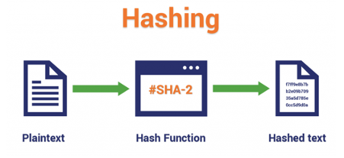
6. Hash Functions
This technique does not involve any key. Rather it uses a fixed length hash value that is computed on the basis of the plain text message. Hash functions are used to check the integrity of the message to ensure that the message has not be altered,compromised or affected by virus.

Slide 56
Hashing
Hashing is the practice of using an algorithm to map data of any size to a fixed length. This is called a hash value (or sometimes hash code or hash sums or even a hash digest if you’re feeling fancy).
Hashing is one-way.
SHA-256 algorithm is going to output a hash value that is 256 bits, usually represented by a 64 character hexadecimal string.
An example of hashing: digitally signing a piece of software and make it available for download on your website.

Slide 57
Common Hashing Algorithms
MD4 – MD4
MD5 – MD5
SHA – SHA stands for Security Hashing Algorithm used in most SSL/TLS cipher suites
RIPEMD
WHIRLPOOL
TIGER

Slide 58
Properties of cryptographic hash functions
Non-reversibility, or one-way function. A good hash should make it very hard to reconstruct the original password from the output or hash.
Diffusion, or avalanche effect. A change in just one bit of the original password should result in change to half the bits of its hash. In other words, when a password is changed slightly, the output of enciphered text should change significantly and unpredictably.
Determinism. A given password must always generate the same hash value or enciphered text.
Collision resistance. It should be hard to find two different passwords that hash to the same enciphered text.
Non-predictable. The hash value should not be predictable from the password.

Slide 59
Improving hash function
Salted hashes
Keyed hash functions
Adaptive hash functions

Slide 60
Application of hash functions
Password Verification
Signature Generation and Verification
Verifying File and Message Integrity

Slide 61
7. Digital Signatures and Certificates

Slide 62
Digital Signatures
Encrypted messages that can be mathematically proven to be authentic
Created in response to rising need to verify information transferred using electronic systems
Asymmetric encryption processes used to create digital signatures

Slide 63
How Digital Signature is created
1. Alice clicks 'sign' in her email application or selects which file is to be signed.
2. Alice's computer calculates the 'hash' (the message is applied to a publicly known mathematical hashing function that coverts the message into a long number referred to as the hash).
3. The hash is encrypted with Alice's Private Key (in this case it is known as the Signing Key) to create the Digital Signature.
4. The original message and its Digital Signature are transmitted to Bob.

Slide 64
How Digital Signature is created
5. Bob receives the signed message. It is identified as being signed, so his email application knows which actions need to be performed to verify it.
6. Bob's computer decrypts the Digital Signature using Alice's Public Key.
7. Bob's computer also calculates the hash of the original message (remember - the mathematical function used by Alice to do this is publicly known).
8. Bob's computer compares the hashes it has computed from the received message with the now decrypted hash received with Alice's message.

Slide 65
Digital Certificates
Electronic document containing key value and identifying information about entity that controls key
Digital signature attached to certificate’s container file to certify file is from entity it claims to be from

Slide 66
Digital Certificates
Asymmetric encryption is used to create digital signatures
Used on the Internet to authenticate both users and vendors
A digital certificate is a unique identifier assigned to a user/vendor by a certification authority to verify the identity of the user/vendor
A certification authority is a private company that certifies the user or vendor is who s/he claims to be
Work together with credit card verification companies or other financial institutions in order to verify the identity of the certificate’s requesters

Slide 67
Digital Certificates
Digital signature is an encrypted attachment added to the electronic message to verify the sender’s identity
The digital certificate received by the user includes a copy of its public key
This digital certificate’s owner makes its public key available to anyone wanting to send encrypted documents to the certificate’s owner

Slide 68
8. Protocols for Secure Communications
IPsec - Internet Protocol Security
IKE - Internet Key Exchange
SSH - Secure Shell
SSL - Secure Socket Layer
HTTPS - Secure Embedded Web Server
RADIUS - Remote Authentication Dial In User Service

Slide 69
References:
Simon Rubinstein-Salzedo. Publisher: Springer, 2018, 259 p.
Computer Security Fundamentals: Computer Security Fundamentals, 2/Edition, William (Chuck) Easttom, II. (2012, Pearson Education Company), ISBN-13:9780789748904
B. Tjaden Fundamentals of Secure Computer Systems Franklin Beedle & Associates 2003.
Public key cryptography - Diffie-Hellman Key Exchange: https://www.youtube.com/watch?v=YEBfamv-_do&t=152s
Public Key Cryptography: RSA Encryption Algorithm: https://www.youtube.com/watch?v=wXB-V_Keiu8
How the RSA algorithm works, including how to select d, e, n, p, q, and φ (phi): https://www.youtube.com/watch?v=Z8M2BTscoD4
Why is Exclusive Or (XOR) Important in Cryptography? https://qvault.io/2020/01/18/why-is-exclusive-or-xor-important-in-cryptography/
Web and Network Communications: https://www.ghs.com/products/comm_security.html

